Slide 1
UTILITY OF THE YEAR

Slide 2
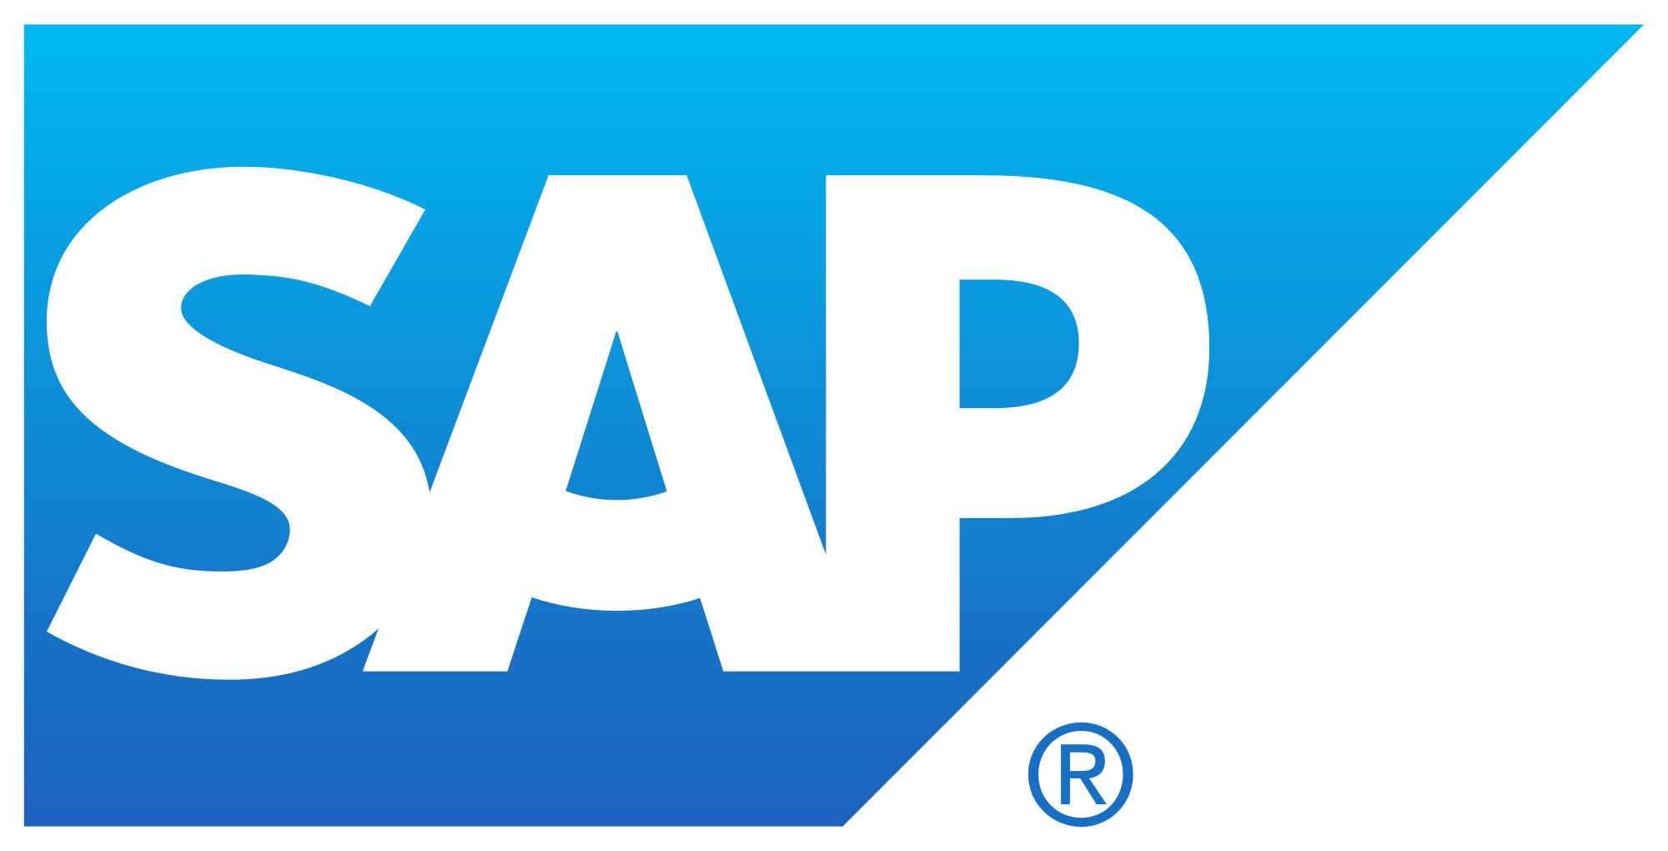
How has this utility differentiated itself from the field? What makes them stand out?
Location: Detroit, MI
Number of Employees: 10,200+
Number of Customers: 2.2 million+
Area Served: Michigan
Challenge:
DTE Energy had a complex CIS architecture which consisted of numerous and disparate data sources that needed to be simplified in the solution landscape. They needed to improve the capabilities in 3 key areas across the business: Customer Service, Billing Back Office, and Revenue Management due to market pressures to deliver new customer innovations faster and more cost neutral. DTE Energy also needed to provide their customers with the options they want through the services that support delivery of multi-channel customized bills, multiple payment options, and automated communications channels such as inbound Interactive Voice Response (IVR), outbound messaging, web communications, and mobile applications.
DTE Energy enabled SAP and partnered with Accenture to create a flexible and robust foundation to build future capability, reduce development time for new products and services, promote a simplified application landscape, standardize business processes, improve operational efficiencies, utilize SAP skilled resources, and improve access to data. DTE Energy focused on reengineering core business processes and ensuring the new technology capabilities will support new products and services. In addition, the new technology would improve delivery against key customer service performance indicators. Across their business units, DTE adopted standardized common processes to drive down implementation costs and invest only in new capabilities that truly differentiate.
How has their business grown? What business results stand out as a product of innovation?
As a result of the implementation, DTE Energy, saw in the short-term:
Improved End User Experience, Improved Customer Analytics, Single view of the customer, Shorter defect lifecycle, Improve Data Access, Reporting, and Analytics, Increased automation, Improved campaign reporting, Consistent multichannel service, Minimize system Outages & disruption, and Improve self-service options for C&I customers
#SAP4UTL

Slide 3
How has this utility differentiated itself from the field? What makes them stand out?
Location: Warwick, United Kingdom
Number of Employees: 25,000+
Number of Customers: 3.4 million+
Area Served: United Kingdom, Massachusetts, New York, and Rhode Island
National Grid has and continues to aggressively adopt SAP cloud solutions while it optimizes and extends it's SAP ERP landscape. What separates National Grid from the field is their continued focus on innovation and leveraging technology to change the way their business operates and drive efficiency. The best example of this innovative and future focused approach is the go-live of their FERC on HANA solution. In an industry consistently adhering to more and more regulatory demands, National Grid designed and deployed a real time FERC reporting offering leveraging SAP S4. With this solution which is the first in NA,
o FI/CO postings are extracted from ECC through the SAP Landscape Transformation server (SLT) to sFin
o Identical G/L transactions are posted in sFin
o Regulatory account posting are derived for each transaction
o Regulatory financial results are available in real time after settlements are complete
How has their business grown? What business results stand out as a product of innovation?
National Grid is pursuing an aggressive roadmap to drive simplification and efficiency across the organization. Key to this strategy of moving to a more effective operating model is their goal of managing end to end processes across an ever distributing ERP landscape with the adoption of cloud technology, a comprehensive controls framework and an integrated data model. Leveraging SAP cloud technology National Grid has:
- Delivered NA’s first real time FERC reporting solution with the adoption of S4
- Initiated an HR Simplification Program of extending their existing SFSF environment and deploying a global instance of SuccessFactors Employee Central spanning both UK and US business
- Started deployment of SAP Concur to simplify and optimize their travel and expense process and spend
- Rolled out SAP Fieldglass to manage their contingent labor workforce
- Continued to leverage SAP Ariba driving strategic sourcing and offering their workforce next generation buying capabilities
#SAP4UTL

Slide 4
How has this utility differentiated itself from the field? What makes them stand out?
Location: Washington, DC
Number of Employees: 1,500+
Number of Customers: 1 million+
Area Served: Washington DC, Maryland, and Virginia
Successful implementation of Project Vision that included the following key SAP applications: Customer Relationship & Billing (CRB) - Suite on HANA, SAP Mobile Work Management, SAP Business Intelligence Suite, and OpenText Document Presentment & Archiving
How has their business grown? What business results stand out as a product of innovation?
WGL implemented the new Customer Information System (“CIS”) solution that will include all software and services required to implement and support the stated interfaces and traditional CIS functions such as customer service, account management, credit and collections, service orders, meter inventory, usage, billing, service address management, portfolio management, rates, and financial based activities. This new CIS replaced the WGL mainframe customer information system implemented in the 1970’s and related systems that supports all of the traditional utility business functions such as meter reading, billing, payment processing, credit, collections, field requests and service work orders.
• SERVICE: Better Functional fit (36%) vs(90+%) CIS without manual workarounds.
• PERFORMANCE: Better risk management, the majority of WG consumer services SOX issues are related to the complexity and limitations of the existing CIS environment. old CS processes require manual workarounds, adding complexity and risk.
• INNOVATION: Cost reductions include eliminating decommissioned systems support, reduced call times with workflows, scripting, and self-service. Cost avoidance include reduced rework with workflows and improved exception processing, eliminating needed uplift & upgrade projects to the existing systems, and improved collections. Revenue enhancement includes reduced bad debt and reduced billing corrections
• DIVERSITY: Original diversity spend goal in RFP was 10%, increase to 16% through testing scope
• SUSTAINABILITY: Current legacy mainframe is 40 year old, home-grown application. SAP offers readily available resources, planned upgrades and a comprehensive user group community.
#SAP4UTL

Slide 5
How has this utility differentiated itself from the field? What makes them stand out?
Location: Minneapolis, MN
Number of Employees: 12,000+
Number of Customers: 5.1 million+
Area Served: Minnesota, Michigan, Wisconsin, North Dakota, South Dakota, Colorado, Texas, and New Mexico
Xcel Energy has flawlessly executed multiple SAP go-lives with complex business transformation requirements. They have remained on target towards their transformational goals and have paved the way for future business efficiencies.
How has their business grown? What business results stand out as a product of innovation?
Xcel Energy has been able to transform the organization from various different operating entities acting independently to one enterprise process branded as One Xcel.
#SAP4UTL

